Slide 1

Relational algebra Afjal H. Sarower Lecturer, Department of CSE,DIU

Slide 2
Relational Algebra
Procedural language
Six basic operators
select: σ
project: ∏
union: ∪
set difference: –
Cartesian product: x
rename: ρ
The operators take one or two relations as inputs and produce a new relation as a result.

Slide 3
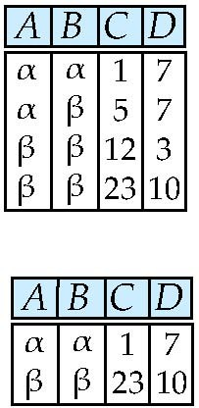
Select Operation – Example
Relation r
^{σ}A=B ^ D > 5 ^{(r)}

Slide 4
Select Operation
•
•
Notation: σ _{p}(r)
p is called the selection predicate
Where p is a formula in propositional calculus consisting of terms
connected by : ∧ (and), ∨ (or), ¬ (not) Each term is one of:
<attribute>op <attribute> or <constant> where op is one of: =, ≠, >, ≥. <. ≤
Example of selection:
^{σ} dept_name=“Physics”^{(instructor)}

Slide 5
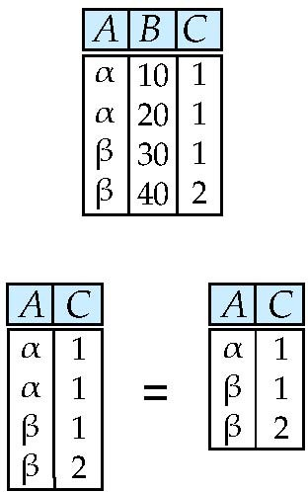
Project Operation – Example
Relation r:
∏_{A,C} (r)

Slide 6
Project Operation
Notation:
∏
A₁, A₂ ,😐, A_{k} ^{(r)}
where A₁, A₂ are attribute names and r is a relation name.
The result is defined as the relation of k columns obtained by erasing the columns that are not listed
Duplicate rows removed from result, since relations are sets
Example: To eliminate the dept_name attribute of instructor
∏ID, name, salary ^{(instructor)}

Slide 7
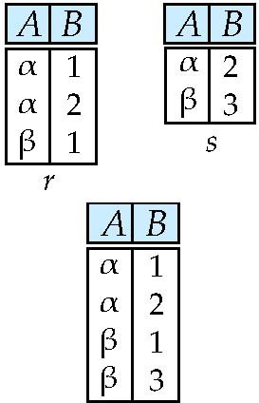
Union Operation – Example
Relations r, s:
r ∪ s:

Slide 8
Union Operation
Notation: r ∪ s
Defined as:
r ∪ s = {t | t ∈ r or t ∈ s}
For r ∪ s to be valid.
r, s must have the same arity (same number of attributes)
The attribute domains must be compatible (example: 2nd column of r deals with the same type of values as does the 2nd column of s)
Example: to find all courses taught in the Fall 2009 semester, or in the Spring 2010 semester, or in both
∏course_id ^{(σ} semester=“Fall” Λ year=2009 ^{(section)) ∪}
∏course_id ^{(σ} semester=“Spring” Λ year=2010 ^{(section))}

Slide 9
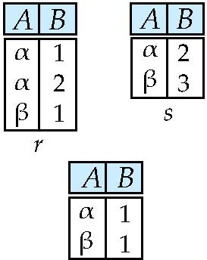
Set difference of two relations
Relations r, s:
r – s:

Slide 10
Set Difference Operation
•
•
Notation r – s
Defined as:
r – s = {t | t ∈ r and t ∉ s}
•
Set differences must be taken between compatible relations.
r and s must have the same arity
attribute domains of r and s must be compatible
Example: to find all courses taught in the Fall 2009 semester, but not in the Spring 2010 semester
∏course_id ^{(σ} semester=“Fall” Λ year=2009 ^{(section)) −}
∏course_id ^{(σ} semester=“Spring” Λ year=2010 ^{(section))}
•

Slide 11
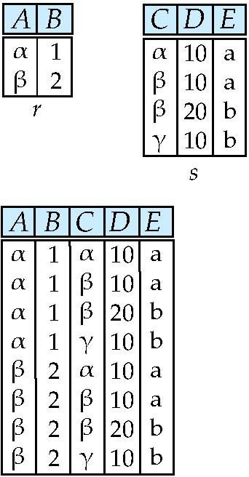
Cartesian-Product Operation – Example
Relations r, s:
r x s:

Slide 12
Cartesian-Product Operation
Notation r x s
Defined as:
r x s = {t q | t ∈ r and q ∈ s}
Assume that attributes of r(R) and s(S) are disjoint. (That is,
R ∩ S = ∅).
If attributes of r(R) and s(S) are not disjoint, then renaming must be used.

Slide 13
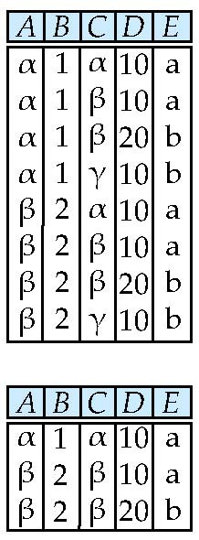
Composition of Operations
Can build expressions using multiple operations
Example: σ_{A=C}(r x s)
r x s
σ_{A=C}(r x s)

Slide 14
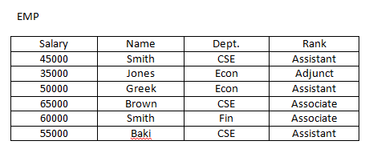
Exercise
Select only those employee who works for CSE Dept.
σ _{Dept=‘CSE’} (EMP)
Find those employees whose rank is associate σ _{Rank=‘Associate’} (EMP)
Find those employees whose name is smith and works as assistant professor.
σ _{Name=‘Smith’} ∧ _{Rank=‘Assistant’} (EMP)

Slide 15
Exercise
Find those employees whose name is smith or works as assistant professor.
σ _{Name=‘Smith’} ∨ _{Rank=‘Assistant’} (EMP)
Select only those employee who are not in cse dept or adjunct.
σ _{Dept=‘CSE’} ∨ _{Rank=‘Adjunct’} (EMP)
σ ¬ (_{Dept=‘CSE’} ∨ _{Rank=‘Adjunct’} (EMP))
Select * from EMP
Where not Dept=cse or not rank= Adjunct

Slide 16
Exercise
Project only names and departments of all employees
∏_{Name,Dept} (EMP)
Show the name, Dept and rank of all employees ∏_{Name,Dept,Rank} (EMP)

Slide 17
Exercise
Show the name of employees working at CSE department. σ _{Dept=‘CSE’} (EMP)
∏_{Name}(σ _{Dept=‘CSE’} (EMP))
Select name from emp
Where dept=‘CSE’

Slide 18
Exercise
Show the name and rank of those employees who are not in CSE department or adjunct professor. σ _{Dept=‘CSE’} ∨ _{Rank=‘Adjunct’} (EMP)
σ ¬ (_{Dept=‘CSE’} ∨ _{Rank=‘Adjunct’} (EMP))
∏_{Name,Rank} ( σ ¬ (_{Dept=‘CSE’} ∨ _{Rank=‘Adjunct’} (EMP)))

Slide 19


Aggregate Functions and Operations
Aggregation function takes a collection of values and returns a single value as a result.
avg: average value
min: minimum value
max: maximum value
sum: sum of values
count: number of values
Aggregate operation in relational algebra
G₁ ,G₂ ,😐,G_{n}
F₁ ( A₁ ),F₂ ( A₂ ,😐,F_{n} ( A_{n} )^{(E)}
E is any relational-algebra expression
^{G}₁^{, G}₂ ^{…, G}_{n} is a list of attributes on which to group (can be empty)
Each F_{i} is an aggregate function
Each A_{i} is an attribute name
Note: Some books/articles use γ instead of (Calligraphic G)

Slide 20
Aggregate Operation – Example
Relation r:
A | B | C
α | α | 7
α | β | 7
β | β | 3
β | β | 10
sum(c^{) (r)}
sum(c )
27

Slide 21

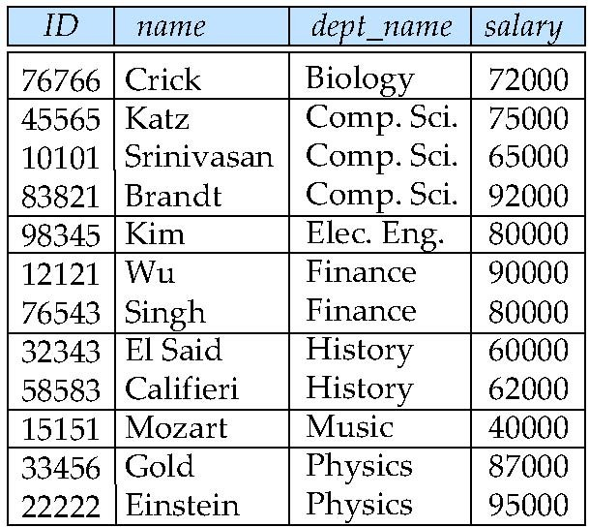
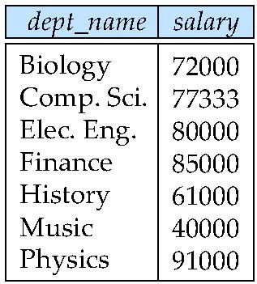
Aggregate Operation – Example
Find the average salary in each department
_{avg(salary)} (instructor)
dept_name
avg_salary

Slide 22
Exercise
What is the minimum salary of employee
F_{MIN(salary)} (EMP)
Select min(salary) from emp
Count the number of employee in Econ Department
σ _{Dept=‘Econ’} (EMP)
F_{count(Name)} (σ _{Dept=‘Econ’} (EMP))
Find the total payroll for the Econ Dept.
σ _{Dept=‘Econ’} (EMP)
F_{SUM (Salary)} (σ _{Dept=‘Econ’} (EMP))

Slide 23




JOIN
Inner join
Full Outer join
Left outer join
Right outer join

Slide 24
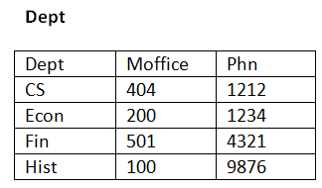
Exercise
Find all the information of every employee including their department information.
(1st table name) _{<joining condition>}(2nd table name)
(EMP) _{(EMP.Dept=Dept.Dept)} (Dept)

Slide 25
Exercise
Employee(person_name, street, city)
Works(person_name, company_name,salary)
Company(company_name,city)
Manages(person_name,mgr_name)
Find the name of all employee who works for FBC
σ _{company name=‘FBC’} (Works)
Find the names and cities of residences of all employees who works for FBC.
σ _{company name=‘FBC’} (Works) =t1
Employee Employee.p_name=Works.p_name τι= τ2
∏_{person, city} (t2))

Slide 26
Exercise
Employee(person_name, street, city)
Works(person_name, company_name,salary)
Company(company_name,city)
Manages(person_name,mgr_name)
Find the name , street address and city of recidence who work for FBC and earn more than 10,000tk.
Table 1 = σ _{company name=‘FBC’} ∧ _{salary>10,000} (Works)
Employee Table 1
∏_{Name,street,city} (Employee Table 1))

Slide 27
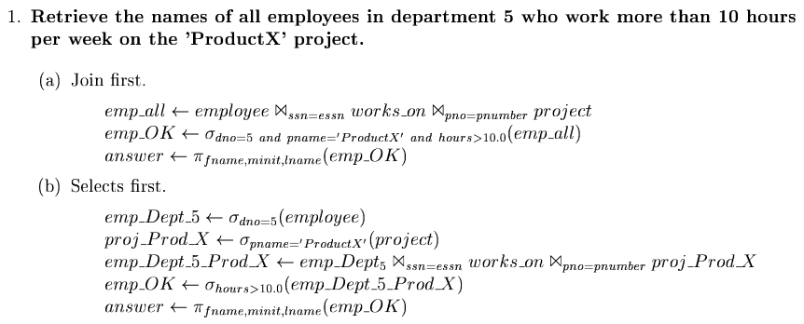
Exercise
Employee(Fname, Mname, Lname, SSN, Bdate, Address, Sex,Salary, Super-SSN, Dno)
Department(Dname, Dnumber, Mgr-ssn, Mgr-start-date)
Dept-Location(Dnumber, Dlocation)
Project(Pname, Pnumber, Plocation, Dnum)
Works-on(Essn, Pno, Hours)
Dependent(Essn, Dependent-name, sex, Bdate, Relationship)

Slide 28
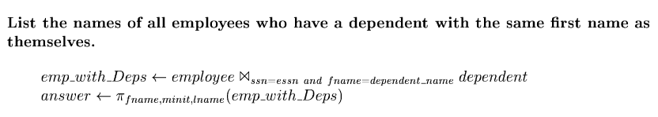
Exercise
Employee(Fname, Mname, Lname, SSN, Bdate, Address, Sex,Salary, Super-SSN, Dno)
Department(Dname, Dnumber, Mgr-ssn, Mgr-start-date)
Dept-Location(Dnumber, Dlocation)
Project(Pname, Pnumber, Plocation, Dnum)
Works-on(Essn, Pno, Hours)
Dependent(Essn, Dependent-name,sex,Bdate, Relationship)

Slide 29
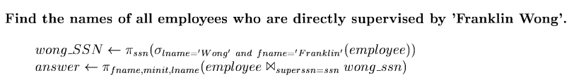
Exercise
Employee(Fname, Mname, Lname, SSN, Bdate, Address, Sex,Salary, Super-SSN, Dno)
Department(Dname, Dnumber, Mgr-ssn, Mgr-start-date)
Dept-Location(Dnumber, Dlocation)
Project(Pname, Pnumber, Plocation, Dnum)
Works-on(Essn, Pno, Hours)
Dependent(Essn, Dependent-name,sex,Bdate, Relationship)

Slide 30
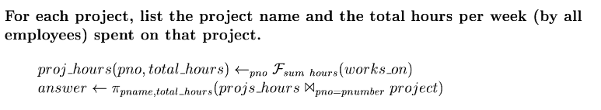
Exercise
Employee(Fname, Mname, Lname, SSN, Bdate, Address, Sex,Salary, Super-SSN, Dno)
Department(Dname, Dnumber, Mgr-ssn, Mgr-start-date)
Dept-Location(Dnumber, Dlocation)
Project(Pname, Pnumber, Plocation, Dnum)
Works-on(Essn, Pno, Hours)
Dependent(Essn, Dependent-name,sex,Bdate, Relationship)

